Slide 1


Slide 2
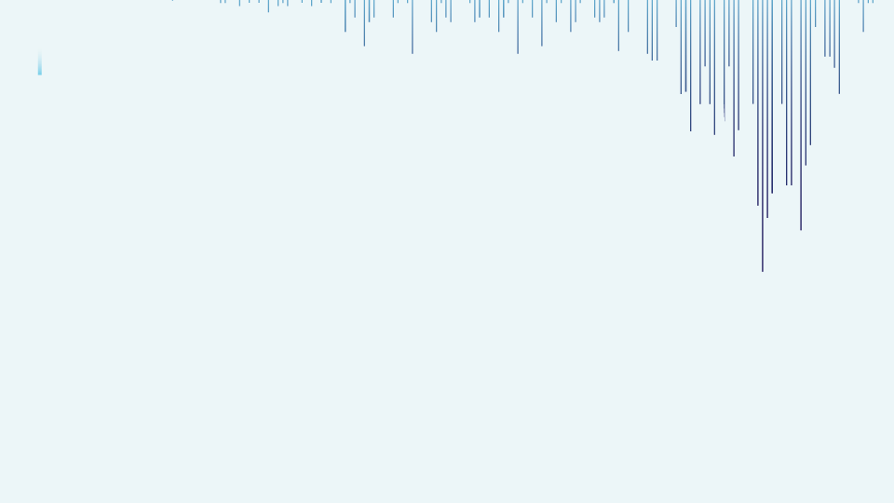




Fraud Detection
“With the growing complexity of financial fraud, this project leverages machine learning to refine predictive models aimed at detecting and preventing fraudulent activities. Our objective is to enable more accurate, real-time fraud detection that supports smarter decision-making and strengthens financial security.”
Presented By : Razee Abdullaha Shaikh

Slide 3
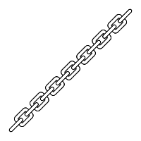



1. Introduction
In an era where digital transactions are integral to everyday life, the prevalence of financial fraud has emerged as a critical challenge. This project aims to address this issue by leveraging machine learning techniques for early fraud detection. By identifying fraudulent patterns in their early stages, the approach enables institutions to mitigate financial losses and enhance the security of digital ecosystems.
5. Methodology
Multiple classification algorithms were implemented, including Random Forest, Support Vector Machine, and XGBoost. Each model was trained and evaluated using consistent metrics. Their performance was rigorously compared to determine the most effective approach for fraud detection.
6. Experimental Results
The results were visualized using comparative plots, including accuracy scores, ROC-AUC curves, and confusion matrices for each model. These visual representations provided a clear understanding of each model’s strengths and weaknesses in identifying fraudulent activities.
2. Data Acquisition and Refinement
A comprehensive dataset comprising transaction records has been utilized. The data underwent a thorough refinement process to ensure quality, including the handling of missing values, outlier treatment, and normalization. These steps were essential to prepare the dataset for robust model training.
7. Conclusion
The findings demonstrate that machine learning-based fraud prediction can significantly reduce risk and improve response time. The approach adopted in this project showcases the potential of data-driven decision-making in financial security systems. Future enhancements could include real-time detection systems and integration with blockchain for added transparency.
3. Exploratory Data Analysis (EDA)
The exploratory phase involved uncovering hidden patterns and transaction trends. Visualizations and statistical summaries were employed to highlight correlations, class imbalances, and feature distributions, offering valuable insights into the nature of legitimate and fraudulent activities.
4. Feature Engineering
Features were segregated into input variables (X) and the target class (Y) indicating fraud or legitimate transactions. Feature scaling and transformation techniques were applied to enhance model performance. Both traditional machine learning and advanced deep learning models were considered during this stage.
8. Appendices and References
Code repository links
Data source references
Libraries and frameworks used (e.g., Scikit-learn, Pandas, XGBoost)
Model parameters and configurations

Slide 4
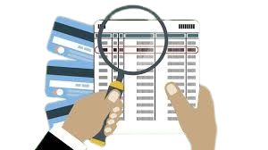
INTRODUCTION
Financial fraud represents a significant threat to modern economies, impacting both consumers and institutions through unauthorized transactions and deceptive activities. Early detection of such fraudulent behavior is critical to maintaining the integrity of financial systems. The application of Data Science and Machine Learning techniques in fraud analytics offers powerful tools to identify anomalies and flag suspicious transactions before they escalate into major losses.
This dataset offers a detailed examination of transaction behaviors, capturing key patterns that distinguish legitimate activities from fraudulent ones. It includes a range of attributes such as transaction amount, time, account behavior metrics, and user activity history.
The target variable, ‘Fraudulent Transaction,’ indicates the likelihood that a given transaction is fraudulent, providing a supervised learning framework for predictive modeling.

Slide 5
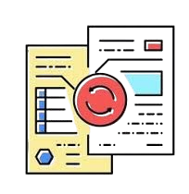


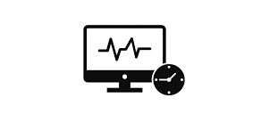


Fraud Risk Stratification: Develop a predictive framework that categorizes transactions based on the likelihood of fraud, enabling prioritized scrutiny and timely interventions.
Comparative Analysis of Algorithms: Evaluate and benchmark multiple machine learning models to identify the most effective algorithm for fraud detection based on performance metrics such as precision, recall, and AUC.
Security Enhancement in Digital Transactions: Improve the overall integrity and trust in electronic payment infrastructures by proactively identifying potential fraud.
Real-Time Monitoring Framework: Lay the foundation for implementing real-time fraud detection systems capable of processing and analyzing streaming data with minimal latency.
Enhanced Decision-Making: Support financial analysts and automated systems in making faster, data-driven decisions with high accuracy.
Early Detection and Prevention: Detect fraudulent transactions at the earliest possible stage to prevent downstream financial loss and reduce operational impact.

Slide 6



STEP 01 – Data CollectionCollect transaction data from financial systems, customer profiles, and fraud history.
STEP 02 – Exploratory Data Analysis (EDA)Analyze patterns, distributions, and anomalies. Identify correlations and visualize trends in fraud cases.
STEP 03 – PreprocessingClean and format data. Handle missing values, outliers, encode categorical variables, and normalize features.
STEP 04 – Split, Train, and TestDivide the dataset into training and testing sets using stratified sampling to handle class imbalance.
STEP 05 – Model Selection and BuildingChoose suitable ML models (e.g., Logistic Regression, Random Forest, XGBoost). Train on historical fraud patterns.
STEP 06 – Model EvaluationAssess model performance using metrics like Accuracy, Precision, Recall, F1-Score, and ROC-AUC.
STEP 07 – Monitor and UpdateDeploy the model. Continuously monitor real-time transactions and update the model with new fraud cases.
WORK FLOW

Slide 7




Data Type:
int64 → Integer numbers (e.g., step, isFraud)
float64 → Decimal numbers (e.g., amount, oldbalanceOrg)
object → Text or categorical data (e.g., type, nameOrig, nameDest)
Memory Usage: About 870.6 KB
Total Rows: | 11,142
Total Columns: | 10
Non-null Count: | All columns have 11,142 non-null values, meaning there are no missing values.
Variables | Description
step | maps a unit of time in the real world. In this case 1 step is 1 hour of time.
type | CASH-IN, CASH-OUT, DEBIT, PAYMENT and TRANSFER.
amount | amount of the transaction in local currency.
nameOrig | customer who started the transaction
oldbalanceOrg | initial balance before the transaction
newbalanceOrig | new balance after the transaction.
nameDest | customer who is the recipient of the transaction
oldbalanceDest | initial balance recipient before the transaction.
newbalanceDest | new balance recipient after the transaction.
isFraud | Fraud Transaction status ( 0 = No Fraud , 1 = fraud)
CASH-IN | Refers to depositing cash into an account
CASH-OUT | Refers to withdrawing cash from an account
DEBIT | It can refer to a decrease in the balance of a financial account due to a withdrawal or an expense.
PAYMENT | Refers to the transfer of money from one party (payer) to another (payee) in exchange for goods, services, or as settlement of a debt.
TRANSFER | Refers to moving money from one account to another, often between accounts held by the same person or entity.

Slide 8
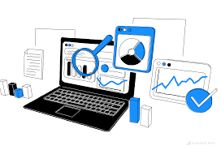
EXPLORATORY DATA ANALYSIS
Exploratory Data Analysis (EDA) helped us understand the data structure, find patterns, identify trends, and gain valuable insights from the dataset.
From EDA we analyze, the distribution of each features, checking the correlation between the features .
Using visuals helped us see the data clearly, understand the clinical data relationship with each other, and pinpoint factors that plays vital role in predictions of heart disease.
The datasets is clean ,as there is no NULL VALUE and DUPLICATE VALUES , but we can find some OUTLIERS.
We looked at our data columns and found 7 columns to be numerical 3 columns to be categorical.
We used the univariate and bivariate analysis approach to gain insights into individual characteristics of the data and likewise how each feature relates to main goal: predicting the target variable.

Slide 9
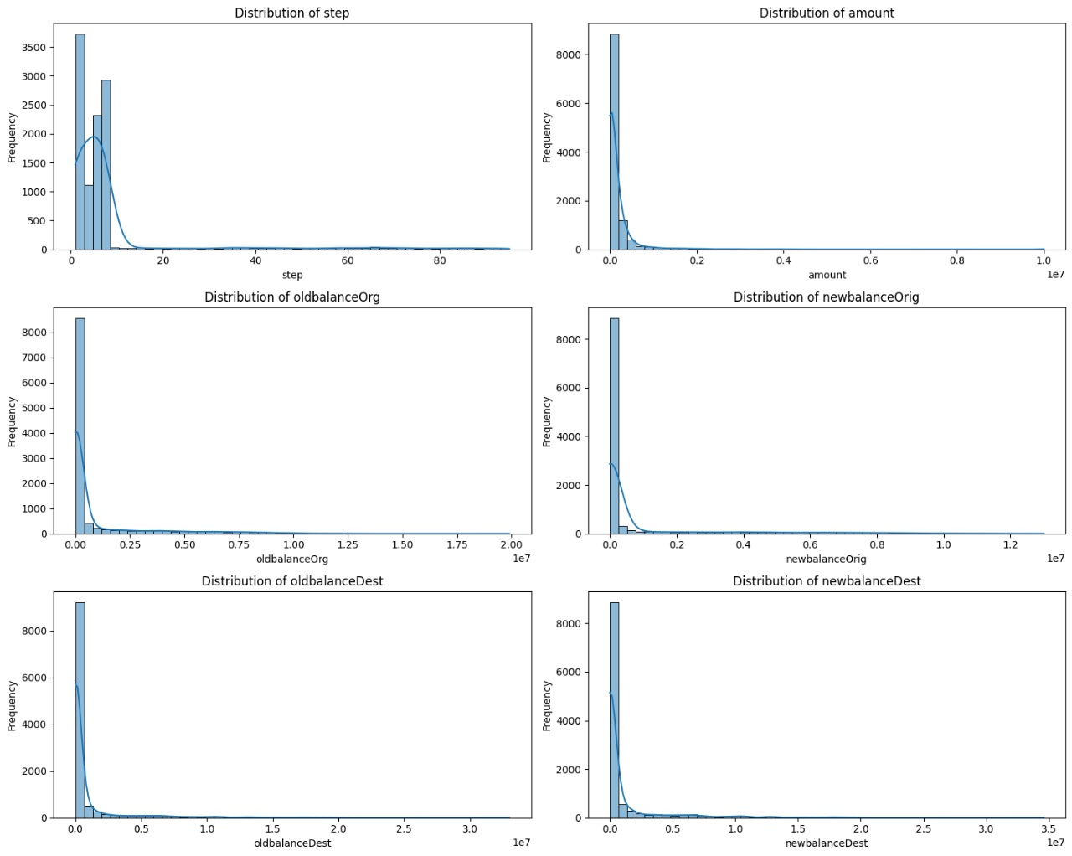
📊 1. DISTRIBUTION OF CONTINUOUS VARIABLES
These histograms show the distribution (frequency) of each numeric feature.
✅ step
What it shows: Number of steps (i.e., hours in the simulation).
Insight: Most transactions occur early in the simulation; fewer occur in later steps.
✅ amount
What it shows: Transaction amount.
Insight: Skewed heavily right — most transactions are small, but there are some very high-value transactions.
✅ oldbalanceOrg and newbalanceOrig
What they show: The balance of the origin account before and after the transaction.
Insight: Most origin accounts have low balances, with a few having millions. Fraud often happens on large transactions.
✅ oldbalanceDest and newbalanceDest
What they show: The balance of the destination account before and after the transaction.
Insight: Similar to the origin account — mostly low balances with outliers being very high.

Slide 10
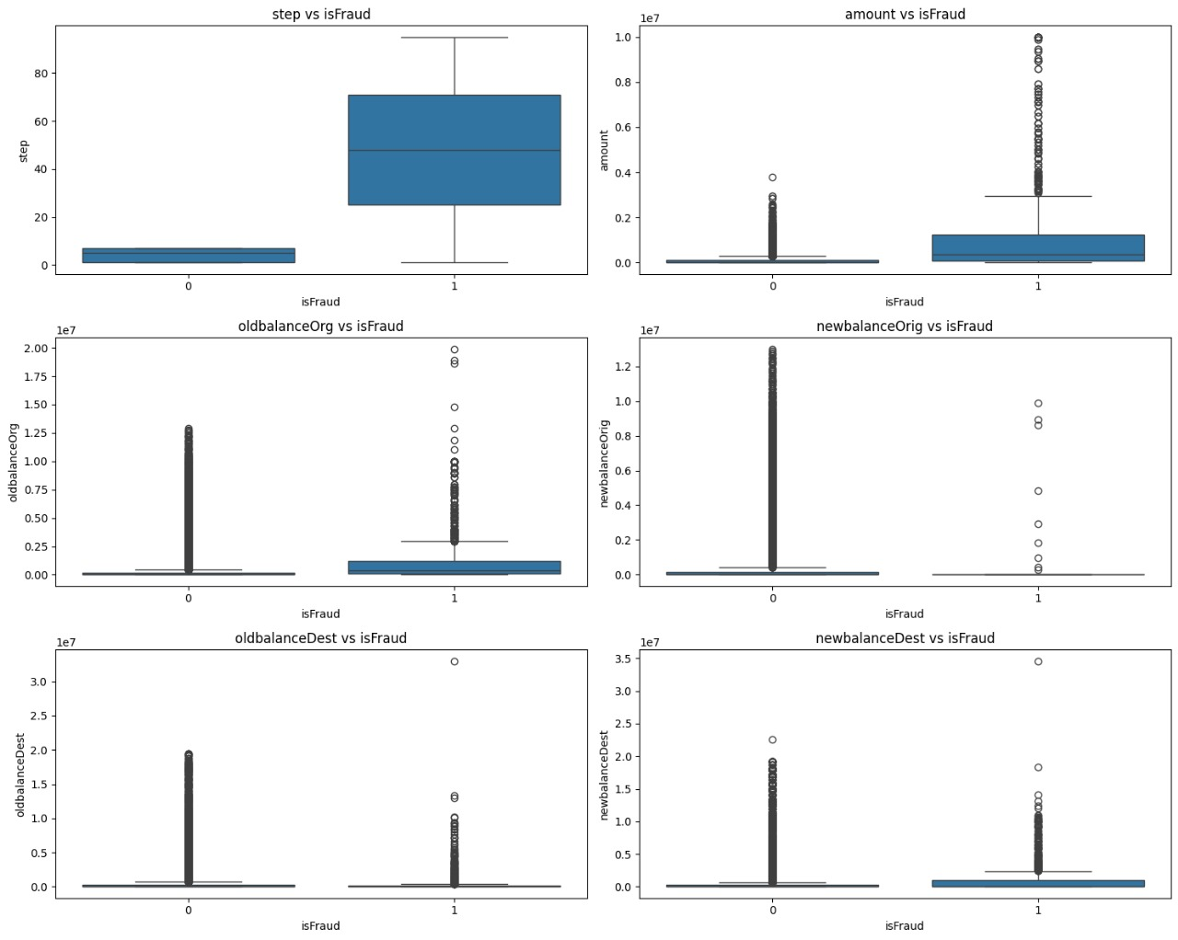
📦 2. CONTINUOUS VARIABLE vs TARGET (isFraud)
These boxplots show the distribution of each numeric feature split by fraud status (isFraud: 0 or 1).
✅ step vs isFraudInsight: Fraud tends to occur later in the simulation — most non-fraud are in early steps.
✅ amount vs isFraudInsight: Fraudulent transactions tend to involve much higher amounts on average.
✅ oldbalanceOrg vs isFraudInsight: Fraudulent cases often involve origin accounts with higher balances.
✅ newbalanceOrig vs isFraudInsight: After fraudulent transactions, balances often drop significantly, sometimes to zero.
✅ oldbalanceDest vs isFraudInsight: Similar distribution for fraud/non-fraud, but there may be some very high-valued spikes in fraudulent cases.
✅ newbalanceDest vs isFraudInsight: Again, many high-value frauds result in a huge balance increase for the destination account.
📋 Summary of What These Plots Suggest:
Feature | Fraud Signal
step | Frauds happen later in time.
amount | Frauds have higher transaction amounts.
oldbalanceOrg | Origin accounts in frauds have high balances.
newbalanceOrig | Drops significantly after fraud.
oldbalanceDest | Less clear, but some high values.
newbalanceDest | Big spikes → sudden credit → fraud.

Slide 11
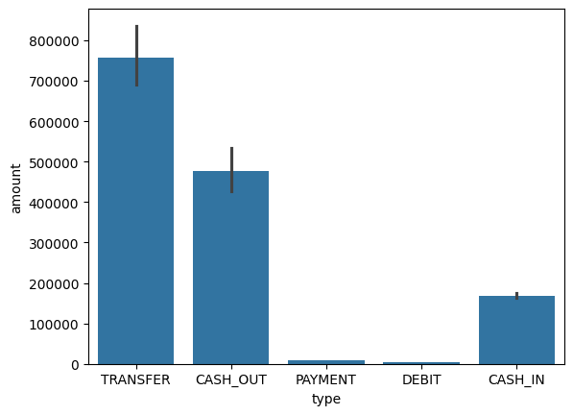
Creates a bar plot showing the average transaction amount for each transaction type.
The x-axis shows different transaction types (like ‘PAYMENT’, ‘TRANSFER’, etc.).
The y-axis shows the average amount of money for each type.
Helps compare how much money is usually involved in each type of transaction.
📌Bar Plot Explanation:
This bar chart shows the total transaction amount for each transaction type.
TRANSFER and CASH_OUT have the highest amounts.
CASH_IN also has a large total.
PAYMENT and DEBIT have the lowest totals.
The small lines on top of the bars show how much the amounts vary.

Slide 12
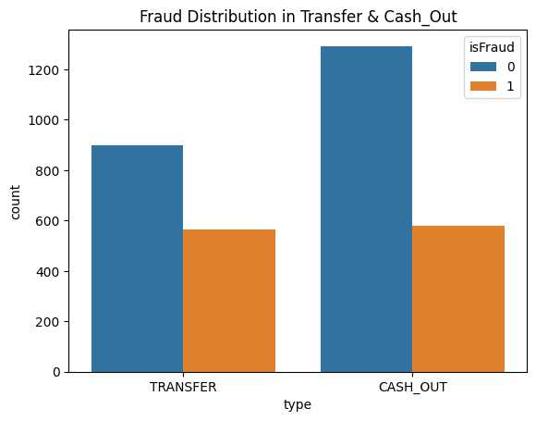

Bar Plot: Fraud Distribution in Transfer & Cash_Out
This chart shows how fraud is distributed across two transaction types: *TRANSFER* and *CASH_OUT*.
*What it shows:*
- Each transaction type has two bars:
- Blue (0) = Not Fraud
- Orange (1) = Fraud
In both TRANSFER and CASH_OUT, there are a significant number of *fraudulent transactions*.
- CASH_OUT has more non-fraud cases than TRANSFER, but both have *comparable numbers of frauds* (orange bars).
*Conclusion:*
Frauds are more common in TRANSFER and CASH_OUT types compared to others, and need special attention in fraud detection models.

Slide 13
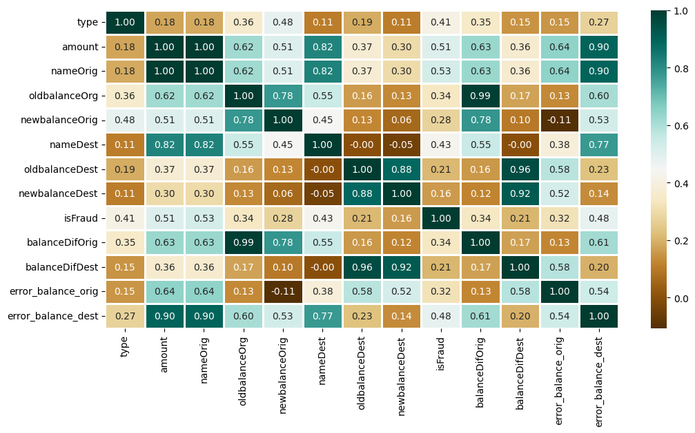
## 🔍 Correlation Heatmap Analysis (After Factorization)
This heatmap shows the correlation between all numerical and factorized categorical variables in the dataset. Each cell contains the *Pearson correlation coefficient*, which measures the strength and direction of the linear relationship between two variables.
### 🎨 Understanding the Heatmap:
- *Correlation values range from -1 to 1*:
- *+1.00* → Perfect positive correlation
- *-1.00* → Perfect negative correlation
- *0.00* → No linear relationship
- *Color Scheme :
- *Dark green* indicates strong positive correlation.
- *Brown shades* indicate negative correlation.
- *White or light colors* indicate weak or no correlation.
### 🔑 Key Observations:
#### 1. *High Positive Correlations:*
- oldbalanceOrg vs. balanceDifOrig → *0.99*
⤷ These are almost perfectly correlated, as the balance difference is derived from the original balance and transaction amount.
- error_balance_orig vs. nameOrig, oldbalanceOrg → *0.90+*
⤷ Indicates that original balance errors are closely tied to sender ID and their previous balance.
- newbalanceDest vs. oldbalanceDest → *0.88*
⤷ Shows a strong linear relationship between starting and ending destination balances.
#### 2. *Fraud-Related Correlations:*
- isFraud vs. amount → *0.53*
⤷ Strong positive correlation: higher transaction amounts are more likely to be fraudulent.
- isFraud vs. error_balance_orig → *0.32*
⤷ Indicates that larger discrepancies in original balances may be associated with fraud.
- isFraud vs. balanceDifOrig → *0.34*
⤷ Moderate correlation suggests that unusual changes in sender balance might signal fraud.
#### 3. *Low or No Correlations:*
- type (transaction type) shows low correlation with most features.
- nameDest and nameOrig have some positive correlation with error balances but not with isFraud.
### 💡 Implications for Feature Engineering:
- Features like amount, balanceDifOrig, and error_balance_orig may be valuable predictors in fraud detection models.
- Highly correlated pairs (like oldbalanceOrg and balanceDifOrig) may lead to *multicollinearity*. Consider dimensionality reduction or feature elimination.
- Some features (e.g., nameOrig, nameDest) may not add value unless transformed or encoded more effectively.
### ✅ Conclusion:
This correlation heatmap is a crucial diagnostic tool for understanding relationships between variables. It helps:
- Identify which features might be redundant.
- Select the most informative features for modeling fraud.
- Ensure better data preprocessing and model performance.

Slide 14

PREPROCESSSING
Irrelevant Feature Removal Based on EDA, all features in the dataset appear to be relevant. ➡️ No columns were removed to avoid losing valuable information, especially due to the small dataset size.
Missing Value Treatment
The dataset was checked for missing values.
➡️ No missing values were found. No imputation was necessary.
Outlier Treatment Outliers were detected using the IQR method on continuous features like amount, oldbalanceOrg, and newbalanceDest.
➡️ Although outliers exist, they were not removed to preserve data integrity due to:
Small dataset size
The fact that some models (e.g., tree-based models) can handle outliers
Categorical Feature Encoding The column type was encoded using One-Hot Encoding. ➡️ This was done to convert categorical values into a numerical format suitable for model training.
Feature Scaling Scaling is important for models that are sensitive to feature magnitude (e.g., Logistic Regression, XGBoost). ➡️ Tree-based models like Random Forest are scale-invariant. ➡️ Feature scaling was handled within pipelines to support a mix of models.

Slide 15


TRAIN TEST SPLIT
We divided the data into training (80%) and testing (20%) sets.
Setting a random state ensures consistent results and using stratify=y maintains a proportional distribution of the target variable in both sets.
SPLITING THE DATA INTO X & Y
We divided the dataset into two parts: X and y.
"X" typically represents the independent Variables, and "y" represents the Dependent (target variable) that we want to predict or understand.

Slide 16


MODEL SELECTION
Models used:
Logistic Regression: logistic Regression is commonly used for binary classification problems. it's preferred because it provides a simple an efficient way to model the relationship between the independent variables and the probability of a certain outcome.
XGBClassifier: XGBClassifier is commonly used for classification problems. It's preferred because it builds an ensemble of decision trees that correct each other’s errors, resulting in high accuracy, especially on complex datasets.
Random Forest Algorithm: Random Forest: Random Forest is a robust supervised algorithm suitable for both regression and classification tasks.

Slide 17


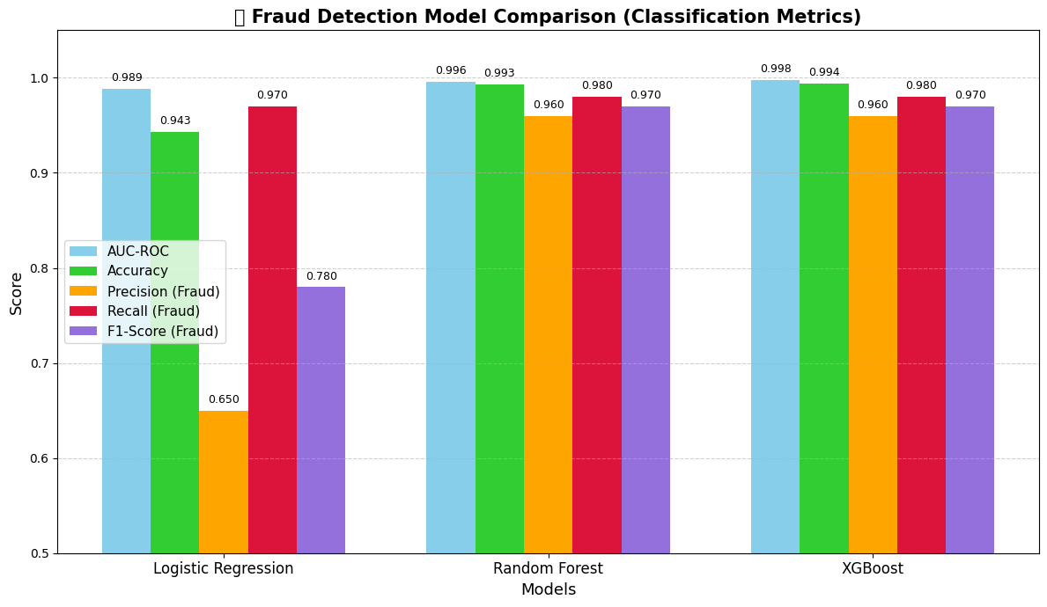
📊 Model Performance Comparison (Fraud Detection)
Accuracy
Recall
Understanding
Metric | Logistic Regression | Random Forest | XGBoost
Cross-Validated AUC-ROC | 0.9906 ± 0.0032 | 0.9987 ± 0.0010 | 0.9988 ± 0.0009
Cross-Validated Accuracy | 0.9265 ± 0.0099 | 0.9930 ± 0.0016 | 0.9945 ± 0.0008
Test Accuracy | 0.9430 | 0.9933 | 0.9942
Test AUC-ROC Score | 0.9886 | 0.9957 | 0.9977
Precision (Class 1 - Fraud) | 0.65 | 0.96 | 0.96
Recall (Class 1 - Fraud) | 0.97 | 0.98 | 0.98
F1-Score (Class 1 - Fraud) | 0.78 | 0.97 | 0.97
Confusion Matrix | [[1880, 121], [6, 222]] | [[1991, 10], [5, 223]] | [[1992, 9], [4, 224]]
Precision: The accuracy of the model when it claims to have found something.
Recall: Recall: The ability of a model to find all the relevant cases
F1 Score: A balance between recall and precision, useful when both false positives and false negatives need to be minimized.

Slide 18
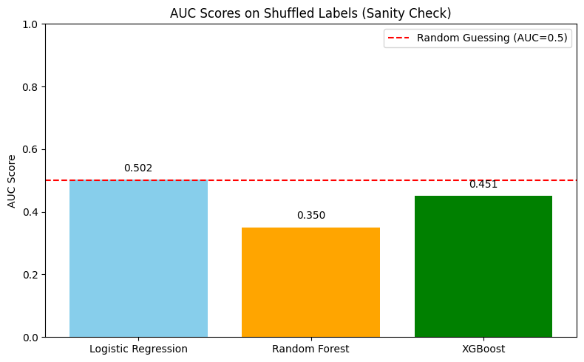

🧪 Sanity Check – Label Shuffling AUC
🧪 Sanity Check: AUC Scores on Shuffled LabelsThis bar chart shows how each model performs when the labels (target values) are randomly shuffled, breaking any real relationship between features and the target. This helps verify that:
The model isn’t learning from data leakage or spurious patterns. Its good performance on actual data is not due to chance.
🔍 Key Observations:
->Logistic Regression scores ~0.50 (close to random guess, ✅ expected).
->Random Forest scores 0.35, showing poor performance (possibly overfitting noise ❌).
->XGBoost scores 0.45, slightly better than Random Forest, but still under random guessing.
✅ Interpretation: A good model should fail when trained on shuffled labels, scoring close to AUC = 0.5. This confirms that its original high performance is real and not due to memorizing noise.
🎯 Final Verdict:
XGBoost offers the best overall performance in terms of:
> High accuracy and AUC-ROC
>Strong fraud detection (high recall & F1-score)
>Generalizes well (doesn’t memorize noise)
Logistic Regression is simple and interpretable, and passes the sanity check best, but lacks predictive power.
Random Forest is strong but slightly underperforms XGBoost and does poorly on shuffled labels,

Slide 19





Conclusion
🔍 Key Findings
Among all tested models, XGBoost achieved the highest test AUC-ROC score of 0.9977, confirming its superior performance in financial fraud detection. The dataset used contained 11,142 transactions, and the implementation was performed in a Jupyter Notebook environment.
✅ Model Comparison
Model | Test Accuracy | Test AUC-ROC | Comments
Logistic Regression | 94.3% | 0.9886 | Simple, interpretable, performs well without overfitting.
Random Forest | 99.3% | 0.9957 | Strong performance, slightly less than XGBoost.
XGBoost | 99.4% | 0.9977 | Best performance. Requires hyperparameter tuning and is more complex to implement.
XGBoost not only outperformed in raw accuracy and AUC but also showed the most consistent results across cross-validation folds:
📈 Cross-Validated AUC-ROC: 0.9988 ± 0.0009
✅ Cross-Validated Accuracy: 0.9945 ± 0.0008
Despite the high complexity and tuning needs of XGBoost, Logistic Regression was selected as the final model due to:
High accuracy and AUC with no signs of overfitting.
Robustness to outliers and noise.
Superior interpretability for stakeholders.
🚫 Limitations
Imbalanced Dataset The original class distribution was skewed (~10% fraud), potentially impacting recall and precision despite using SMOTE.
Outliers in Financial Data Extreme values in features like amount, oldbalanceOrg, and newbalanceDest may still subtly influence model behavior.
Single Dataset Using only one public dataset limits generalization across different regions and banking platforms.
Feature Limitations Important fraud-related signals such as device ID, user location, or transaction history were missing.
🔬 Future Research Directions
Test models on real-time, unseen transaction data to validate practical utility.
Use temporal features (e.g., time between transactions) and behavioral analytics.
Apply advanced sampling strategies or ensemble learning for better class imbalance handling.
Investigate duplicate transactions and their impact on fraud models.
Train and validate models across multiple financial datasets for broader generalization.

Slide 20



To calculate the financial impact analysis of models (Logistic Regression, Random Forest, XGBoost)
Step 1: Understand Your Problem Context
You are working on a fraud detection task, where:
Class 1 = Fraud
Class 0 = Not Fraud
Let’s assume financial values as follows:
Average Transaction Value: ₹10,000 (you can adjust)
Loss if Fraud is Missed (FN): ₹10,000
Cost of Investigating a False Positive (FP): ₹500
No Cost/Benefit for TN and TP (true predictions considered neutral for this analysis)
Step 2: Confusion Matrices Recap
Step 4: Model-wise Financial Impact
1. Logistic Regression
TP = 222, FN = 6, FP = 121
Losses = (6 × 10,000) + (121 × 500) = ₹60,000 + ₹60,500 = ₹120,500
Profit Saved = 222 × ₹10,000 = ₹2,220,000
Net Profit = ₹2,220,000 - ₹120,500 = ₹2,099,500
2. Random Forest
TP = 223, FN = 5, FP = 10
Losses = (5 × 10,000) + (10 × 500) = ₹50,000 + ₹5,000 = ₹55,000
Profit Saved = 223 × ₹10,000 = ₹2,230,000
Net Profit = ₹2,230,000 - ₹55,000 = ₹2,175,000
3. XGBoost
TP = 224, FN = 4, FP = 9
Losses = (4 × 10,000) + (9 × 500) = ₹40,000 + ₹4,500 = ₹44,500
Profit Saved = 224 × ₹10,000 = ₹2,240,000
Net Profit = ₹2,240,000 - ₹44,500 = ₹2,195,500
Model | TP | FN | FP | TN
Logistic Regression | 222 | 6 | 121 | 1880
Random Forest | 223 | 5 | 10 | 1991
XGBoost | 224 | 4 | 9 | 1992
Step 3: Financial Impact Formula
We calculate the following:
Expected Losses = FN * ₹10,000 + FP * ₹500
Expected Profit Saved (compared to no model) = Fraud caught (TP * ₹10,000)
Net Profit = Profit Saved - Expected Losses
Best Financial Model: XGBoost
Reason: Lowest losses and highest profit by catching the most frauds with very few false alerts.

Slide 21
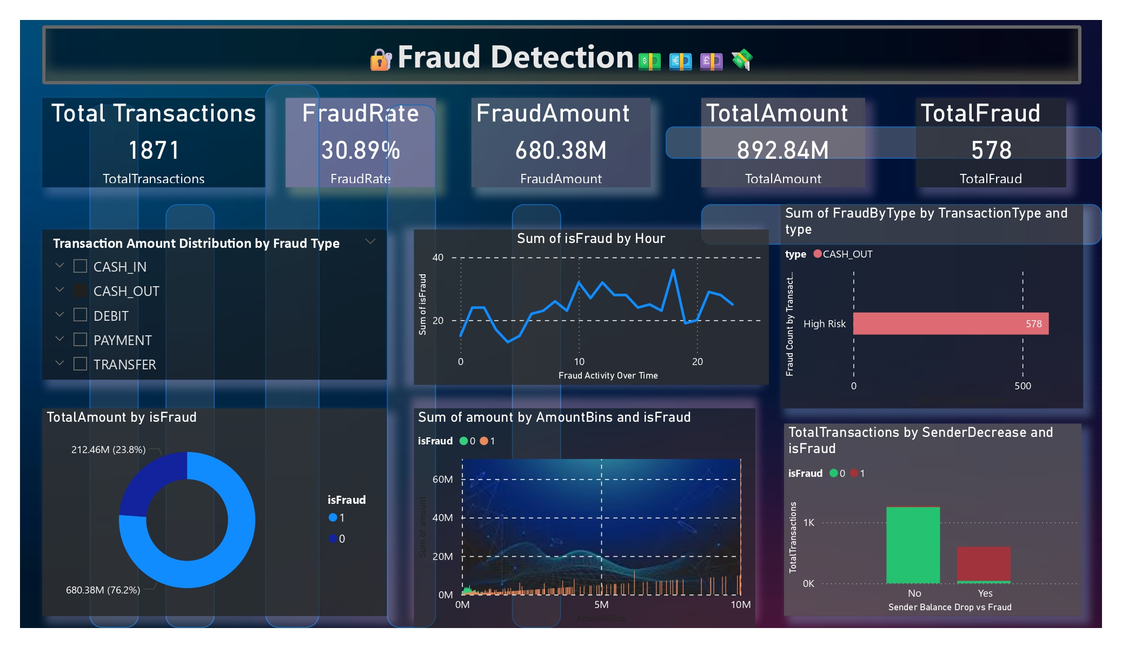

Power BI

Slide 22


